Slide 1
Homeostasis & Receptors by Dr.Vani Gupta

Slide 2
Homeostasis
Homeostasis - maintaining internal stability within an organism and returning to a particular stable state after a fluctuation.
The word homeostasis was introduced by Walter B Cannon in 1930

Slide 3
Parts of Body involved
kidneys :
regulate water & mineral salts concentration
skin :
regulate body temperature
liver & pancreas :
regulate blood glucose level

Slide 4
skin
tissue cells
kidney
blood
liver
pancreas

Slide 5
Role of Various Systems of The Body In Homeostasis
Body Temperature
Blood pressure
Blood pH
O₂ and CO₂ concentration
Osmoregulation-Water balance
Blood glucose

Slide 6
Mechanisms- What goes up, must come down
Thermoregulation
Sweating (cooling) vs. shivering (warming)
Blood Pressure
Vasconstriction vs. vasodilation
Osmoregulation
Hypotonic vs. hypertonic

Slide 7
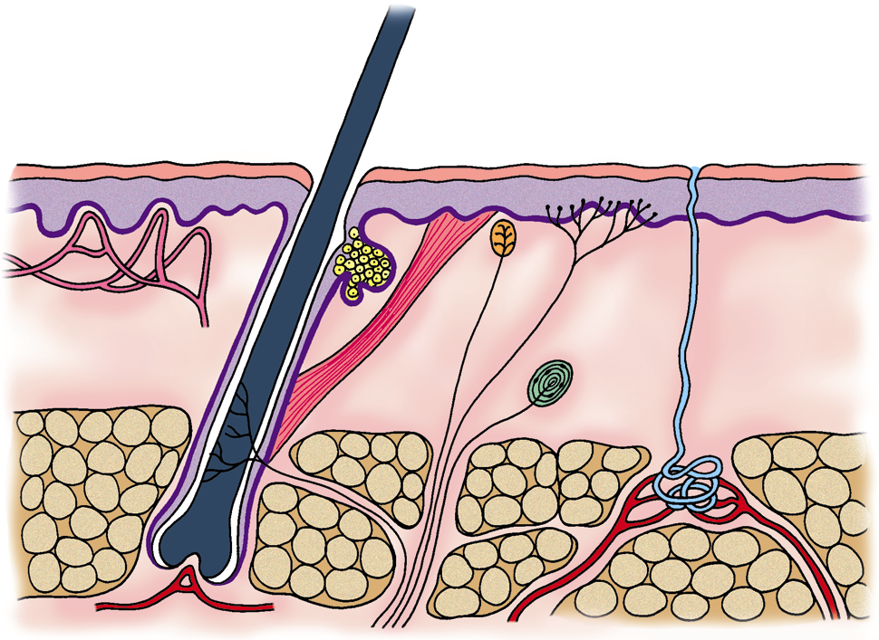
Thermoregulation (Regulation of Body Temperature)
Hair follicle
Sebaceous gland
Erector muscle
Receptors
Epidermis
Dermis
Blood capillaries
Skin is responsible for Temperature Regulation

Slide 8
Control of Body Temperature in Hot Conditions
More sweat is produced by sweat glands
evaporation of sweat takes away heat which produces a cooling effect
Vasodilation of skin arterioles
arterioles near the surface of the skin dilates
to let more blood flows near the skin surface
to have more heat lost by conduction & radiation.

Slide 9
Erector muscles relax
hairs lie flat on the skin
reduce thickness of air trapped among the hairs (not effective in human because human’s hairs are short)
Develop thinner subcutaneous fat & shed their fur
as long term responses
increase heat loss
Decrease metabolic rate & muscle contraction
gain less heat

Slide 10
Control of Body Temperature in Cold Conditions
Vasoconstriction of skin arterioles
arterioles near the surface of the skin constrict
to let less blood flows near the skin surface
to have less heat lost by conduction & radiation
Erector muscles contract
pull hairs erect for trapping more air
thicker layer of air acts as a good insulator of heat

Slide 11
Less sweat is produced by sweat glands
reduce heat loss by evaporation
Develop thicker subcutaneous fat & thicker fur
as long term responses
reduce heat loss
Increase metabolic rate & muscle contraction
gain more heat

Slide 12
Regulation of Blood Glucose Level
controlled by Negative feedback mechanism
controlled by insulin secreted from the islets of Langerhans in pancreas
Diabetes - malfunction of pancreas (does not secrete enough insulin)

Slide 13
Pancreas secretes insulin
Liver coverts glucose to glycogen
Soon after a meal
Too High
Blood glucose level falls
normal blood glucose level
normal blood glucose level
Long after a meal
Pancreas secretes less insulin
Liver converts glycogen to glucose
Too Low
Blood glucose level rises

Slide 14
Osmoregulation (Water & Mineral salts)
After having a very salty meal
produce concentrated urine to remove excess salts in solution form
extra water is needed to be excreted along with the excess salts
sensation of thirst (drink more water to compensate for the water loss)

Slide 15
Hormonal Control via Negative Feedback

Slide 17
Receptors

Slide 18
Receptors
These are proteins, to which hormones bind. They are present on cell membranes, cytoplasm and nucleus, and serve two functions.
Receive messages from chemical messengers coming from other cells
Transmit a message into the cell leading to a cellular effect
Receptors are specific for chemical messengers
Each cell has a range of receptors on the cell membrane making it responsive to different chemical messengers

Slide 19
Structure and function of receptors
Nerve
Nerve
Signal
Messenger
Receptor
Response
Nucleus
Cell
Cell

Slide 20
Mainly Two Function
Selectivity of the cell
Effecter mechanism in the cell .
Selectivity – Lock and Key Theory
Effecter mechanism- receptor have two domains.
Binding domain
Signal generation domain

Slide 21
Chemical Messengers
Neurotransmitters: Chemicals released from nerve endings which travel across a nerve synapse to bind with receptors on target cells, such as muscle cells or another nerve. Usually short lived and responsible for messages between individual cells
Hormones: Chemicals released from cells or glands and which travel some distance to bind with receptors on target cells throughout the body

Slide 22
Types of Receptors
Cytoplasmic Receptors
Cell Surface Receptors
Nuclear Receptors
G- protein receptors

Slide 23
Cell Surface Receptors
There are three types of cell surface receptors:
Ion channel receptors,
Transmembrane receptors,
Receptors that are kinases or bind kinases

Slide 24
Ion channel receptors
When a signaling molecule binds to an ion channel on the outside of the cell, this triggers the change of the 3D conformation of the protein and the channel opens, allowing the ions to move in or out of the cell following their electrical gradients and thus altering the polarization of the cell membrane..
Some ion channels respond to non-chemical stimuli in the same way, including changes in electrical charge or mechanical disturbance of the membrane

Slide 25
Receptors that are kinases or bind kinases
When a signaling chemical binds to the membrane receptor protein on the outside of the cell, this triggers a change in the 3D conformation of that protein, which in turn, triggers a chemical reaction on the inside of the cell.
Transmembrane proteins
include G protein-linked receptorsTransmembrane proteins include G protein-linked receptors and they are seven-pass trans membrane proteins. This means that the polypeptide chain traverses the membrane seven times. When a chemical - a hormone or a pharmaceutical agent - binds to the receptor on the outside of the cell, this triggers a series of chemical reactions:

Slide 26
Cytoplasmic Receptors
Once inside the cell, they (Steroid hormones) bind cytoplasmic receptors.
This causes receptor activation.
This receptor which has hormone bound to it and DNA sequence now serves as a binding site for other co activator proteins.
Thus the gene begins to be transcribed and translated, and a new protein appears in the cell and assumes its normal function within it (or gets secreted).

Slide 27
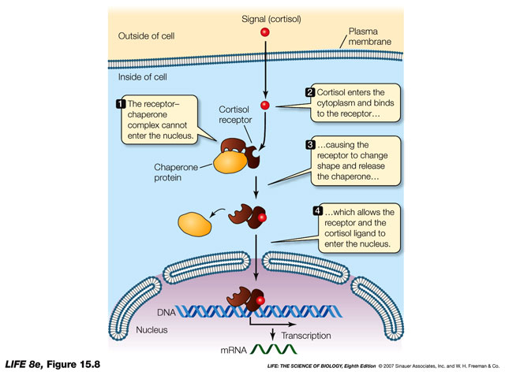

Slide 28
Nuclear Receptors
Nuclear receptors have the ability to directly bind to DNA and regulate the expression of adjacent genes, hence these receptors are classified as transcription factors.
A unique property of nuclear receptors that differentiates them from other classes of receptors is their ability to directly interact with and control the expression of genomic DNA. As a consequence, nuclear receptors play key roles in both embryonic development and adult homeostasis.

Slide 29
G- protein receptors
Basic G-protein Receptor
ligand binds to receptor (outer surface of cell).
receptor changes shape (inner surface of cell).
shape change allows receptor to bind inactive G-protein
inactive G-protein = G-alpha + GDP + G-beta + G-gamma
inactive G-protein binds to receptor
receptor activates G-protein
G-alpha drops GDP, picks up GTP
when G-alpha binds GTP --> G-beta and G-gamma are released

Slide 31
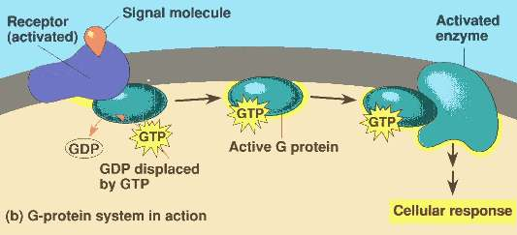

Slide 32
Q.1- Homeostatic regulation of body temperature is an example of:
a) disease stage
b) negative feedback
c) positive feedback
d) Receptor mediated regulation.
Notes:
Ans-c

Slide 33
Q.2-Which organ system protects against environmental hazards, helps regulate body temperature, and provides sensory information?
a) Integumentary system
b) Cardiovascular system
c) Endocrine system
d) Digestive system
Notes:
Ans-a

Slide 34
Q.3-Which of the following statements regarding blood pressure is not true?
a) Blood pressure is constant throughout the body.
b) Blood pressure varies throughout the cardiac cycle.
c) Blood pressure is regulated by the renin-
angiotensin-aldosterone pathway.
d) Blood pressure can be altered by adrenaline.
Notes:
Ans-a

Slide 35
Q-4.Which of the following hormones is not important in calcium homeostasis?
a) Calcitonin
b) Parathyroid hormone
c) 1,25-dihydrocycholecalciferol
d) Glucagon
Notes:
Ans-d

Slide 36
Q-5.Which of the following strategies would not help restore a high body temperature to normal?
a) Non-Shivering thermogenesis
b) Sweating
c) Flattening of skin hair
d) Redistribution of blood flow to the periphery
Notes:
Ans-a

Slide 37
Q-6.Which organ systems are the most important systems for maintaining homeostasis?
a) muscular and digestive
b) nervous and endocrine
c) nervous and excretory
d) excretory and integumentary
Notes:
Ans-b

Slide 38
Q-7.Which of the following statements best describes homeostasis?
a) Keeping the body in a fixed and unaltered state.
b) Dynamic equilibrium.
c) Maintaining a near-constant internal environment.
d) Altering the external environment to accommodate the body's needs.
Notes:
Ans-c

Slide 39
Q-8. Which of the following is an effector activated by the hypothalamus when the temperature of the body is lower than the set point?
a) sweat glands initiate sweating
b) move to a warmer location or put on a sweater
c) skeletal muscles contract
d) skin blood vessels dilate
Notes:
Ans-c

Slide 40
Q-9- How is thermal energy transferred through sweating?
a) evaporation
b) convection
c) radiation
d) conduction
Notes:
Ans-a

Slide 41
Q-10.What elements are involved in homeostatic mechanisms?
a) thermoreceptor, set point, and effector
b) sensor, integrator, and effector
c) stimulus, sensor, and effector
d) sensor, responder, and effector
Notes:
Ans-b

Slide 42
Q-11. Which of the following statements is not true about receptors?
a) Most receptors are proteins situated in the cell membrane.
b) Receptors contain a hollow or cleft on their surface which is known as a binding site.
c) Receptors bind chemical messengers such as neurotransmitters or hormones.
d) Receptors catalyse reactions on chemical messengers.
Notes:
Ans-d

Slide 43
Q-12.Which of the following statements is not true about neurotransmitters?
a) Neurotransmitters are released by nerves.
b) Neurotransmitters are required to carry a 'message' from a nerve to a target cell.
c) Neurotransmitters have significant distances to cover to reach their target cells.
d) Neurotransmitters bind to receptors on target cells.
Notes:
Ans-c

Slide 44
Q-13.Which of the following is not a neurotransmitter?
a) acetylcholine
b) cyclic AMP
c) noradrenaline
d) dopamine
Notes:
Ans-b

Slide 45
Q-14.Which of the following statements is not true regarding the binding site of a receptor?
a) The binding site is normally a hollow or cleft in the surface of a receptor.
b) The binding site is normally hydrophobic in nature.
c) Chemical messengers fit into binding sites and bind to functional groups within the binding site.
d) The binding site contains amino acids which are important to the binding process and a catalytic mechanism.
Notes:
Ans-d

Slide 46
Q-15.Which of the following statements is not true about a ligand-gated ion channel receptor?
a) Ligand-gated ion channel receptors are present in the cell membrane.
b) Neurotransmitters can act as the chemical messengers for ligand-gated ion channels.
c) Ligand-gated ion channels consist of five glycoproteins.
d) Differences in membrane potential affect whether ligand-gated ion channel receptors open or close.
Notes:
Ans-d

Slide 47
Q-16. Which of the following is not a G-protein coupled receptor?
a) the muscarinic receptor
b) the glycine receptor
c) the adrenergic receptor
d) the glutamate receptor
Notes:
Ans-b

Slide 48
Q-17.Which of the following statements is true regarding intracellular receptors?
a) They consist of three protein subunits.
b) They contain a ligand binding site near the C-terminal end.
c) They contain a binding region for DNA near the N-terminal end.
d) They are activated by hydrophobic molecules which are synthesised within the cell.
Notes:
Ans-b

Slide 49
Q-18.Which of the following statements is true about a tyrosine kinase linked receptor?
a) It is situated in the cytoplasm.
b) The N-terminal chain is intracellular.
c) The ligand binding site is in the N-terminal chain.
d) It has two hydrophobic transmembrane regions.
Notes:
Ans-c

Slide 50
Q-19.Which of the following is not a typical messenger for a tyrosine kinase linked receptor?
a) insulin
b) acetylcholine
c) growth factors
d) cytokines
Notes:
Ans-b

Slide 51
Q-20.Which of the following statements is not true about G-protein coupled receptors?
a) They generally mediate the action of fast acting neurotransmitters.
b) They mediate the action of some hormones.
c) They activate signal proteins called G-proteins.
d) Histamine can act as a ligand for some G-protein coupled receptors.
Notes:
Ans-a

